Slide 1


Systems Modeling Guided Bone Regeneration
Xiaobo Zhou, Ph.D.
Center for Bioinformatics & Systems Biology
Wake Forest University School of Medicine, Winston-Salem, NC
Peter Yang, Ph.D.
Department of Orthopaedic Surgery and Material Sciences
Stanford University Medical School, Stanford, CA

Slide 2
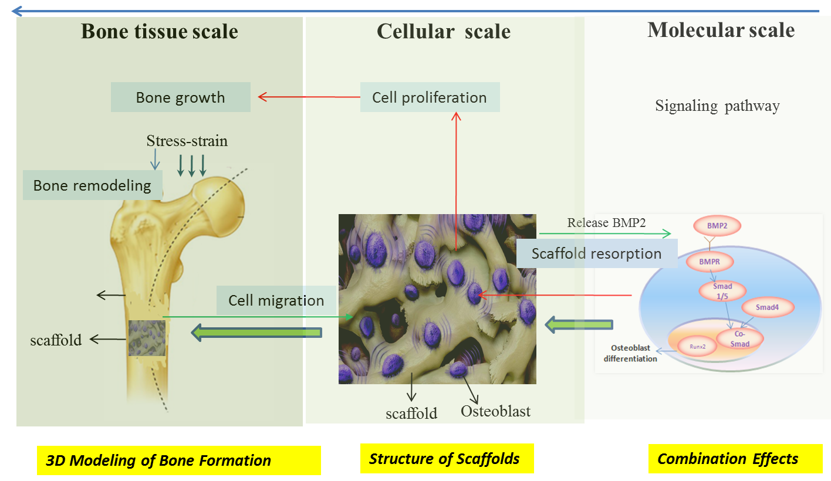
Multi-scale Models for Bone Regeneration within Scaffolds
Sun, et. al., Biomaterials, 2012, 2013

Slide 3
The three aims of the sBone
1. To develop an in vitro multi-temporal scale model for optimizing temporal combinations of GFs to promote bone regeneration.
2. To construct a predictive multi-scale model of bone regeneration within the novel pre-vascularized macro-porous β-TCP scaffolds loaded with a programmed GF release system.
3. To guide the design of chemo-physical features of bone scaffolds by in silico optimization of GF release profiles and geometric parameters of the macro-pores.
1U01AR069395-01A1

Slide 4
3D multi-scale bone regeneration
sBone within a growth factor-loaded porous biodegradable β-TCP scaffold. VEGF is added in the HUVEC cell medium instead of loading into the scaffold directly.

Slide 5
Major components of modeling in sBone
sBone has a wide range of applications since it accounts for almost all important factors for scaffold-based bone regeneration:
Pre-vascularization
Controllable cytokine delivery system
Mechanical stress
3D multi-scale modeling of bone forming
Optimized geometric and biochemical properties of the scaffold
Other applications:
  Tissue remodeling process: i.e., If the bone defects occur on the cranial, the mechanical stress might be not critical, and the model can be simplified by just closing the corresponding component
  Tumor growth modeling
  Drug delivery modeling

Slide 6
A description of key components of the Model Credibility Plan
The whole systems will be validated by in vivo experiments and tested by third party;
The data and tools can be accessible for use and download by research community

Slide 7
Timeline and milestones of the Model Credibility Plan

Slide 8
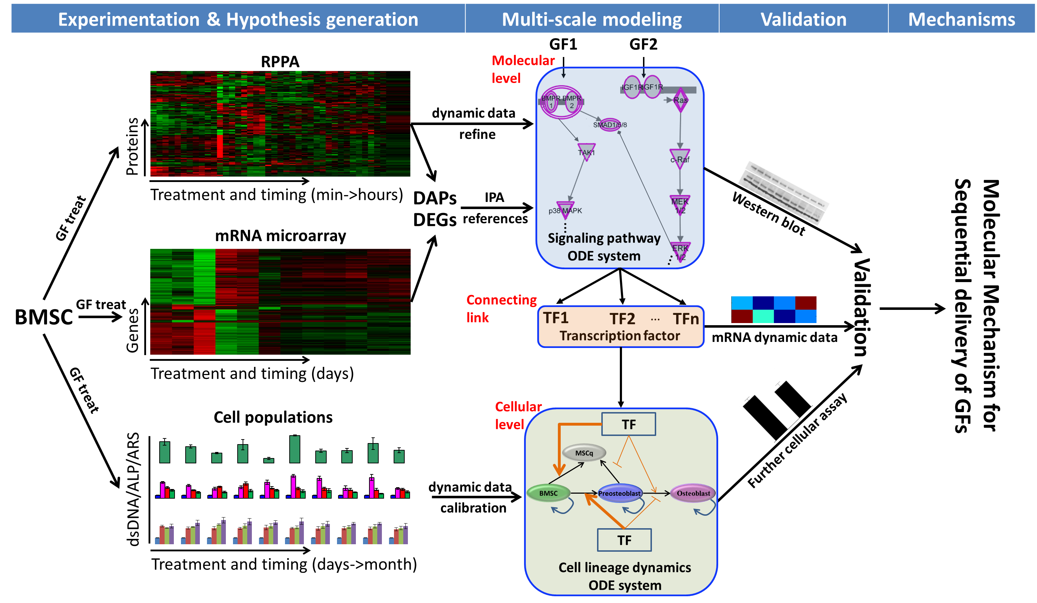
Progress of the Model Credibility Plan
(accomplishments/planned activities)
Systems biology approach to studying the molecular mechanisms for sequential delivery of growth factors
(Tan et al, npj Regenerative Medicine 2017)

Slide 9
Optimal temporal combinations of growth factors
A
B
Experimental results for ALP (Alkaline Phosphate) activity (A), dsDNA (double stranded DNA) mass (B) and ARS (Alizarin Red S) staining (C) under different treatment conditions in W-20-17 cells. Data are presented as mean ± SD (n=4), *P<0.05 and **P<0.001 with two-tailed Student’s t-test.
C

Slide 10
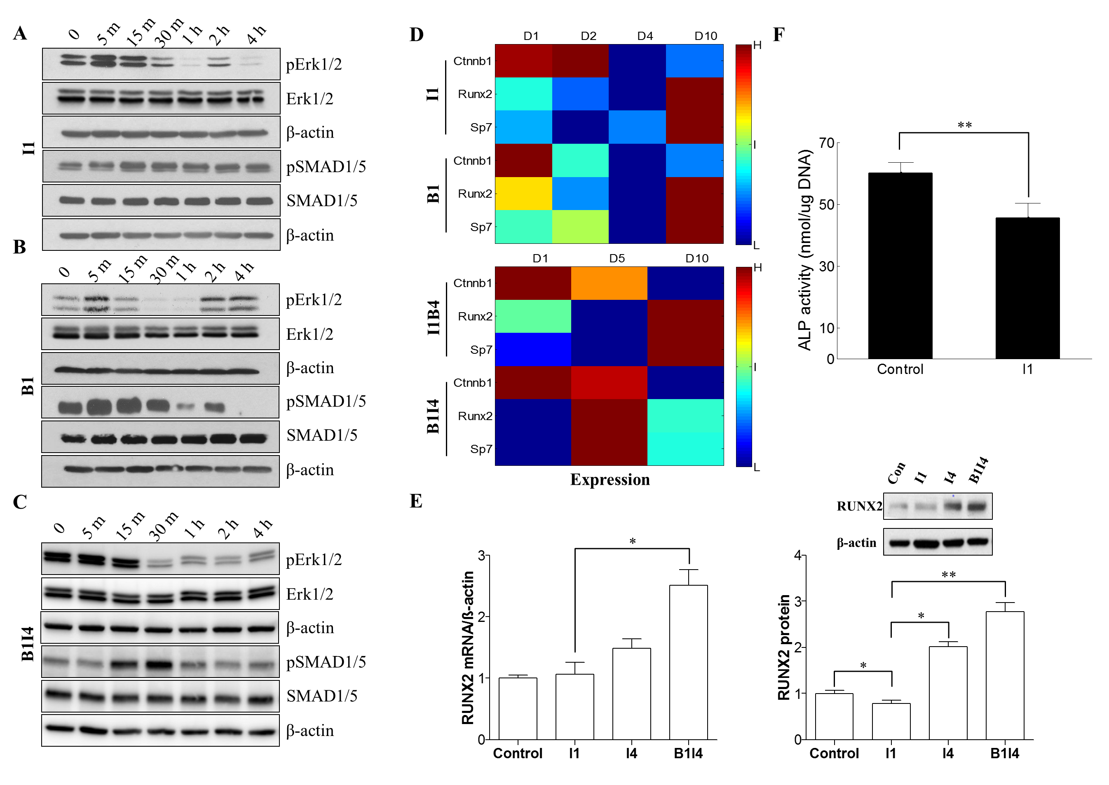
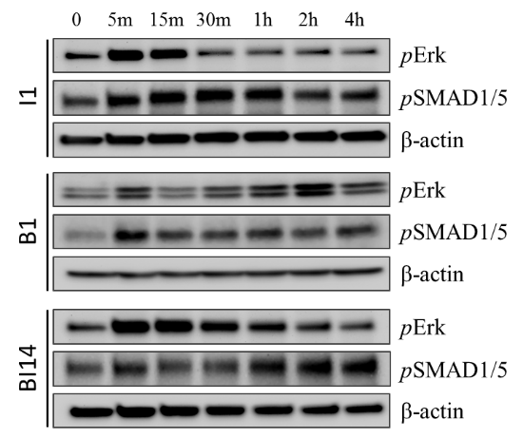
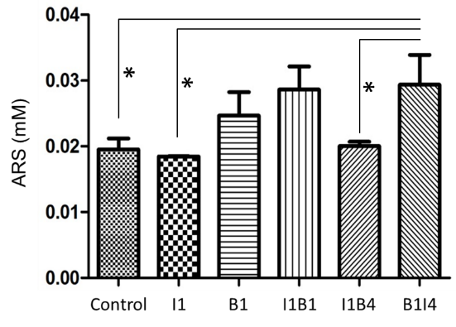
Experimental validation of critical molecular interactions and cytokine functions
G
H
IGF-1 inhibits SMAD via activating ERK. (A-F) W-20-17 cells; (G-H) MC-3T3 cells

Slide 11
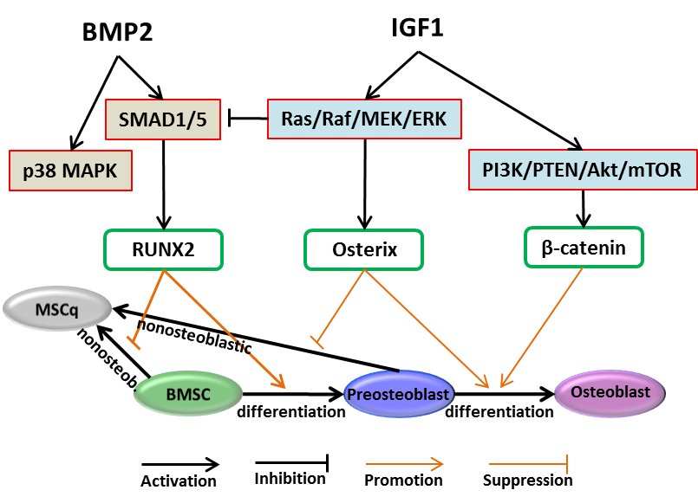
Osteoblastic differentiation related molecular mechanism under combined cytokine treatment
Runx2 is essential for early stage of MSC differentiation, while osterix and β-catenin plays a vital role in proliferation and later stage of bone cell differentiation.

Slide 12
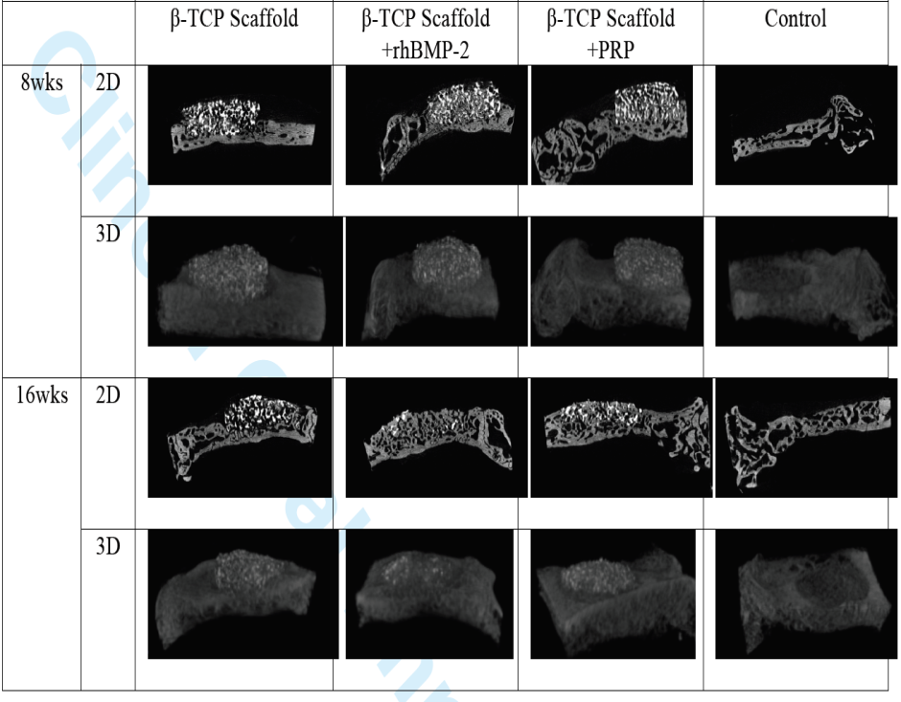
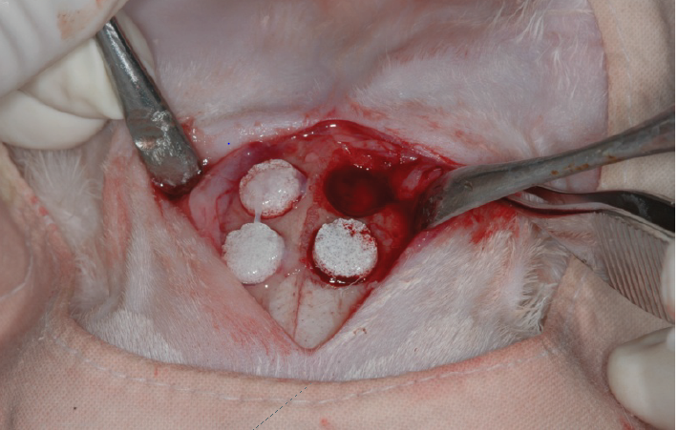
In Vivo Experiments
Micro-CT images of specimens
β-tricalcium phosphate (TCP) scaffolds was put in a rabbit cranial bone
Yang, et al. Mater Sci Mater Med., 2013

Slide 13
3D sBone regeneration system
Engineered scaffolds provide specific geometric structures and surface chemistries as well as accurately release drugs and growth factors to promote both bone regeneration (from the MSCs toward a health and well functional osteoblast lineage) and vascularization between the scaffolds and the host blood vessel system.

Slide 14
Effect of Pore Size on Release Curves
a
Predictions of cumulative released BMP2 from scaffolds as a function of different pore sizes.
b
Pore size= 480 µm
c
Pore size= 720 µm
Notes:
Predictions of cumulative released BMP2 from scaffolds with (a) small pore size (480 µm) and (b) big pore size (720 µm), compared with our experimental data.

Slide 15
Effect of Pore Size and Porosity on Angiogenesis and
Bone Formation
a
b
c
d
Notes:
Predicted effects of scaffold porosity and pore size on angiogenesis and bone formation. (a) Initial porosities of scaffolds with different pore sizes. (b) Normalized numbers of endothelial cells (c) active osteoblasts; and (d) bone mass as a function of different pore sizes after 4 and 8 weeks, respectively.

Slide 16
Growth Factor Combination Prediction
a
Case | Wnt dose | BMP2 dose | VEGF dose
a | 10 | 0 | 0
b | 0 | 10 | 0
c | 4 | 2 | 4
d | 2 | 4 | 4
b
c
The most efficient growth of active osteoblasts was promoted by the combination of Wnt, BMP2, and VEGF
Sun, et. al, Biomaterial, 2013
Notes:
Growth factor combination prediction. (a) The evolution of the numbers of active osteoblasts from day 1 to day 56 under different therapies. (b) The normalized number of endothelial cells under different therapies evaluated in 4th and 8th week. (c) The normalized bone mass under different therapies evaluated in 4th and 8th week. The most efficient growth of active osteoblasts was promoted by the combination of Wnt, BMP2, and VEGF (case c and d). The number of endothelial cells increased dramatically in therapies with VEGF (case c and d) compared with therapies without VEGF (case a and b). More bone formation was observed after 8 weeks when different growth factors were combined together (case c and d) than the therapies of single growth factor (case a and b).

Slide 17
MSC lineage commitment and neo-vascularization w/o mechanical stress within scaffold

Slide 18
Challenges and opportunities with the
Model Credibility Plan
Since our model will be first developed and tested by in vitro experiments, the scaffold degeneration process, cytokine release, vascularization, and mechanical stress dynamics tend to change in in vivo environment, which possibly necessitates much more animals for model calibration and validation;
The interaction between scaffold and adjacent normal tissue might induce immune responses, resulting in unexpected consequence, needs to be addressed in model and in experiments;
Translation of the model to clinic might be a big challenge. The resultant signaling switch upon scaffold implanting might be confounded by the preloaded cytokines and scaffold-triggered host secretion. New methodologies and strategies need to be developed to characterize such kind of underlying molecular mechanisms.

Slide 19
Uniqueness of the Model Credibility Plan (e.g. what are some special considerations built into the plan resulting from specific modeling/simulation situation?)
We need to optimize several factors simultaneously:
the HUVEC:BMSC ratio for pre-vascularization, the temporal order and timing of multiple cytokine delivery, the geometric parameters of the scaffold
These components need to be optimized separately first, and then combined, we will deliver a model that can be tested component-by-component and at the whole system level by third party evaluators
We proposed the novel hybrid construct of soft hydrogel and rigid scaffold for better osteogenic and angiogenic lineage and consequently for optimal bone regeneration

Slide 20
Acknowledgements
Research Collaborations:
  Bioinformatics Center: Drs. Hua Tan, Weiling Zhao, Sun, XQ, Zhiwei Ji, Ruoying Chen;
  Other major collaborators: Drs. Yang YP group;
Major Funding Resources
  NIH 1U01AR069395-01A1
THANKS!

